Slide 1
Elmira integral project

Slide 2
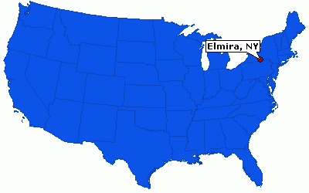
Elmira, new york
We live in a special place
Here we are!

Slide 3
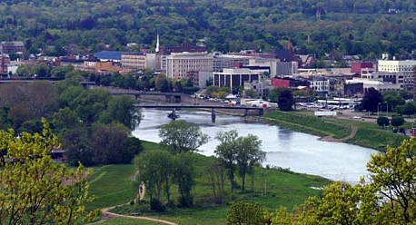
Our Wonderful city
Let's think for a minute about

Slide 4
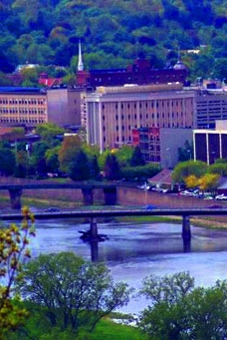
What are elmira's gifts?
Friendly people
Manageable size
Rich, progressive history
Affordable living
Natural beauty
Cultural opportunities
College town
Wegmans!
Can you think of more?

Slide 5
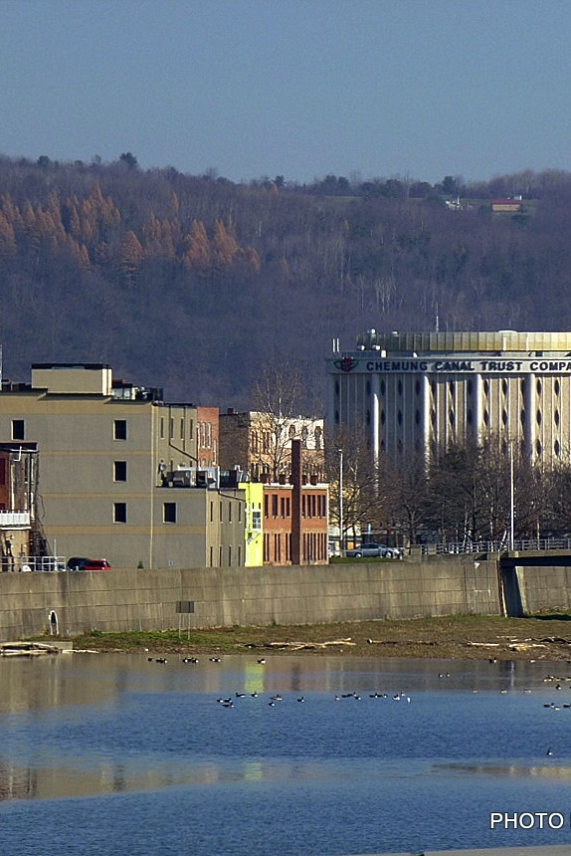
What are elmira's challenges?
Poverty, crime, prison families
Limited opportunities
Low morale, low esteem, hopelessness
Entrenched leadership lacking in VISION
Crappy weather (for some)
Few good eating establishments
What else makes you sad, angry or cynical about Elmira?

Slide 6
“Cynicism is the post-modern disease.
Cynicism means you already know.
What is it that you know?
That it is not possible. What's not possible? EVERYTHING.
In my thinking, cynicism is merely an excuse
not to change.”
–Andrew cohen

Slide 7
You would not be here tonight if you were cynical about Elmira and her future :)

Slide 8
What are some of the ways we participate in this renaissance?
Elmira is emerging out of decades of resignation
Go on, BRAG A LITTLE!

Slide 9
And ideas are emerging.
This is all a big experiment.

Slide 10
"Don't ask what the world needs. Ask what makes you come alive, and go do it. Because what the world needs is people who have come alive."
–Howard thurman

Slide 11
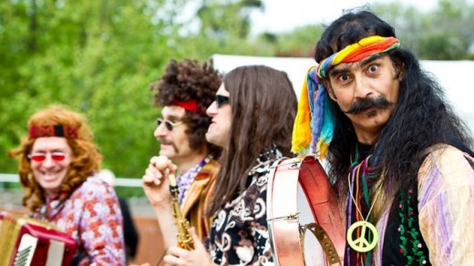
Other ideas may inspire
but end up feeling naïve
Some ideas are practical and conservative, yet uninspiring

Slide 12
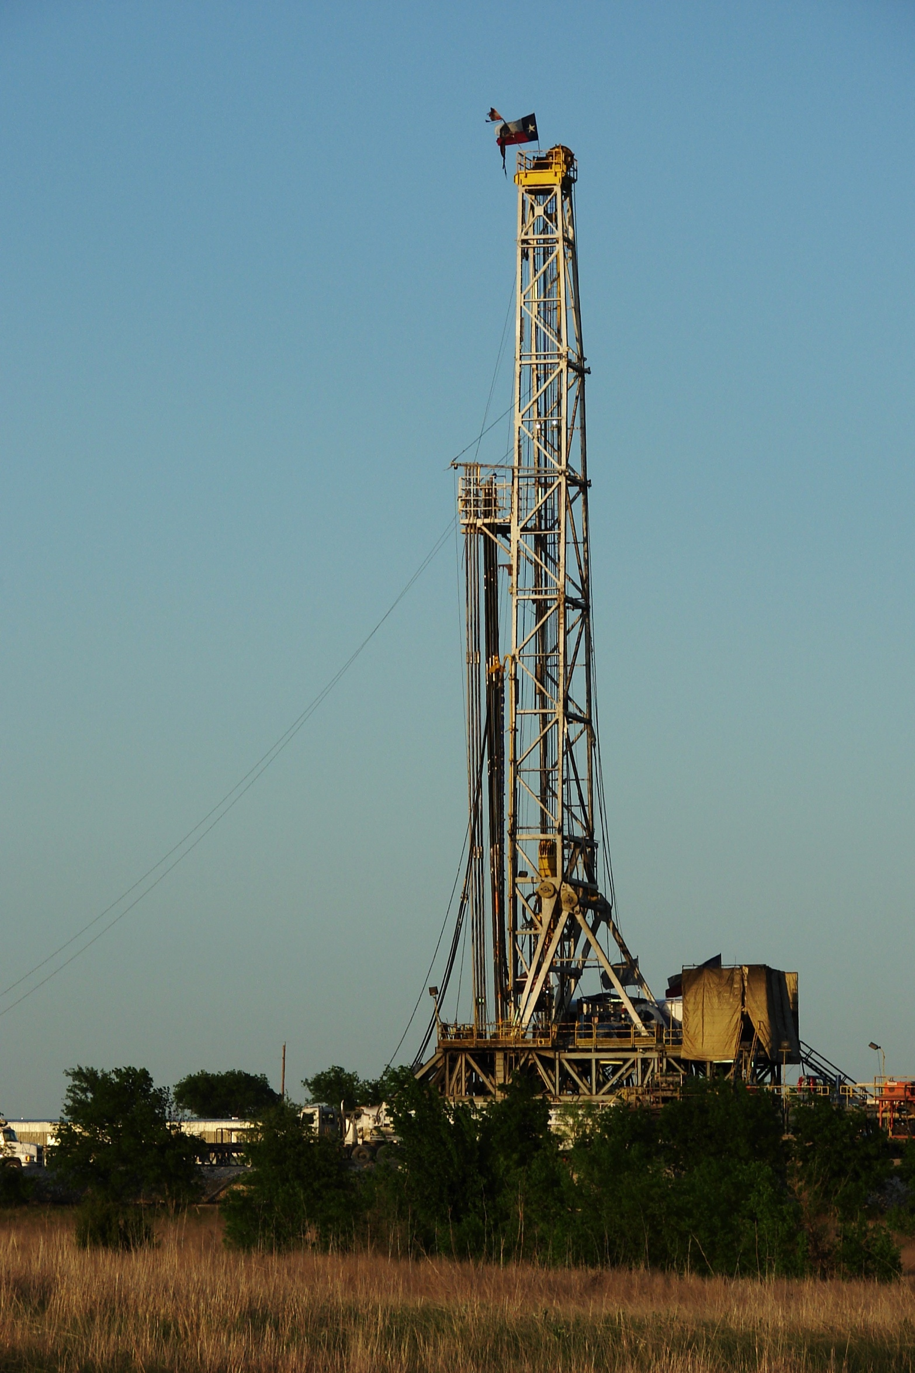
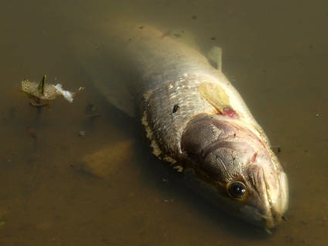
But at what cost?
Some projects bring in a lot of money, and we all agree money can be a good thing.
And how will it move culture forward?

Slide 13
Elmira's problems, and the world's problems are a crisis of consciousness

Slide 14
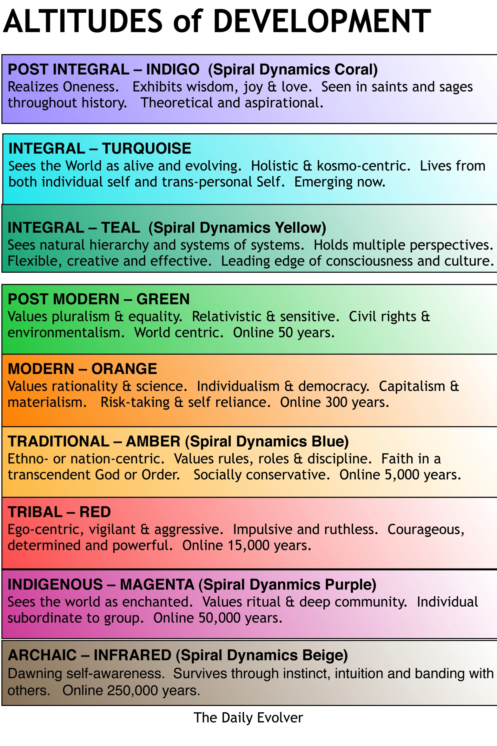
Worldviews develop holarchically
INFRARED is physiological survival.
MAGENTA is tribal with a magical world view.
RED is warrior-like and egocentric.
AMBER is traditional conformist.
ORANGE is modernist and rational-scientific.
GREEN is postmodern, sensitive and world-centric.
TEAL is integral, flexible, and can hold multiple perspectives. The Spiral Wizard.

Slide 15
Integral is practical
Organizational styles REFLECT the prevailing worldview of the founders and board members
Each emergent worldview has its natural style of organization
Integral organizations make room for people to show up fully

Slide 16
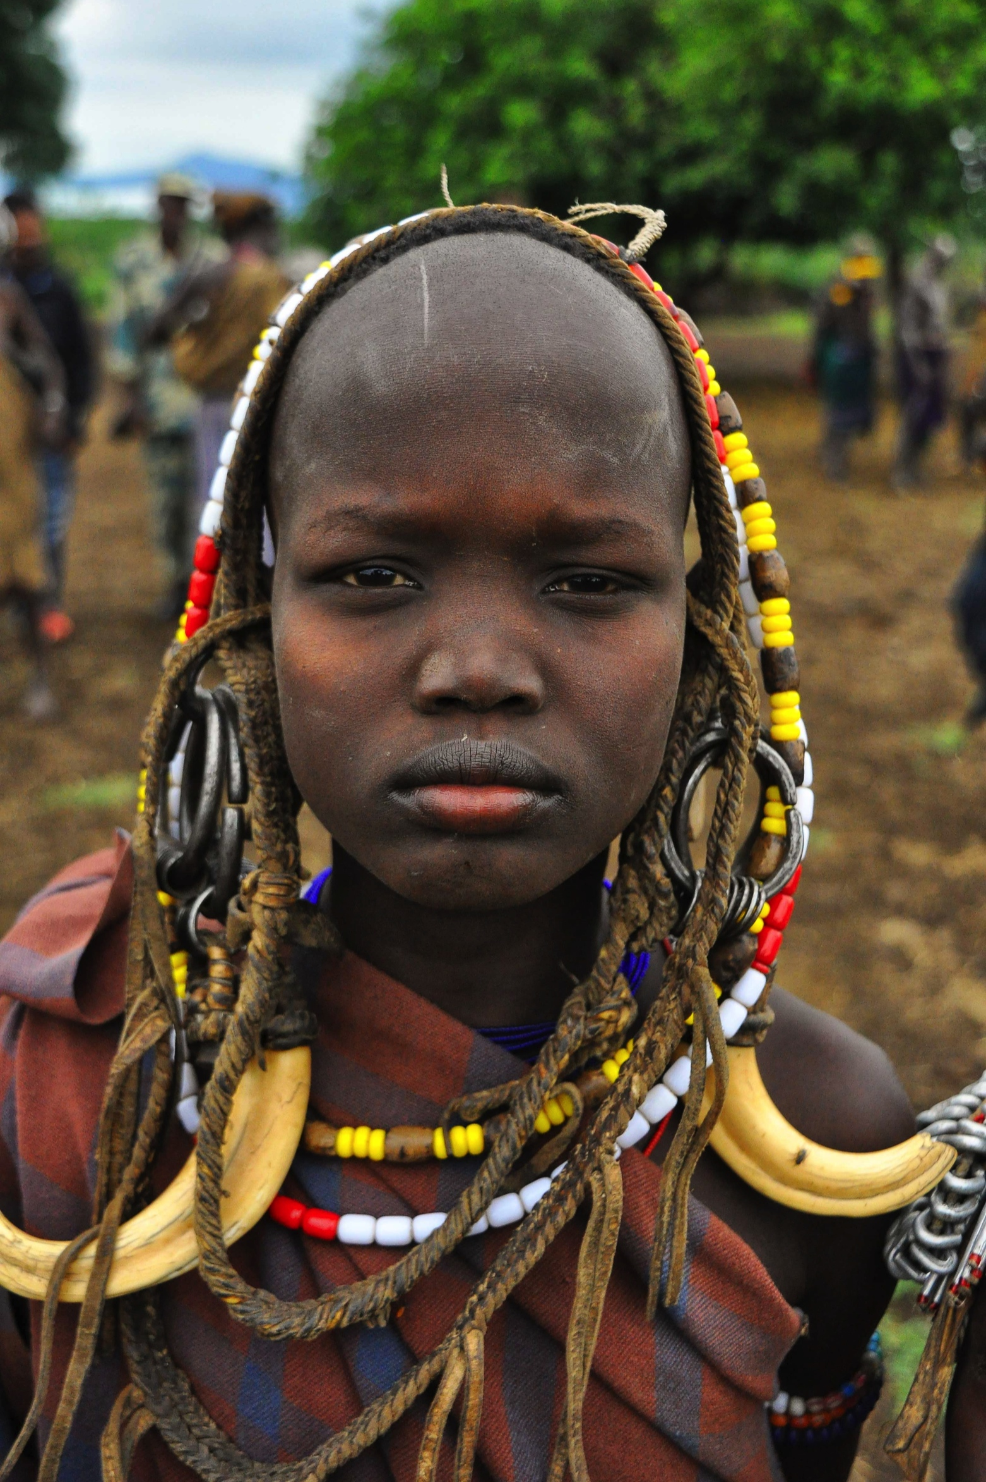
Magenta - tribal organization
Family bonds
Up to a few hundred people
Only the immediate clan falls in the scope of moral consideration
Our group is the center of the universe, though unconsciously so
Gifts: creates richness of community out of the chaos of just staying alive

Slide 17
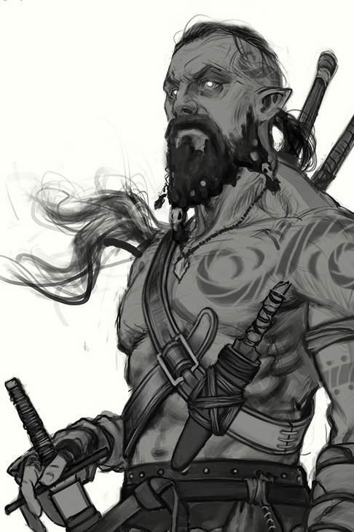
Impulsive-red organizations
Thrives in chaotic environments
Constant exercise of power by chief to keep troops in line
Fear is the glue
Highly reactive, short-term focus
Breakthroughs: division of labor, command authority
Metaphor: wolf pack
Mafia, street gangs, militias
Gifts: strong sense of self, individual rights based on strength
Limitations: inability to organize beyond 3-4 degrees of power, high rates of murder; thrives on instability

Slide 18
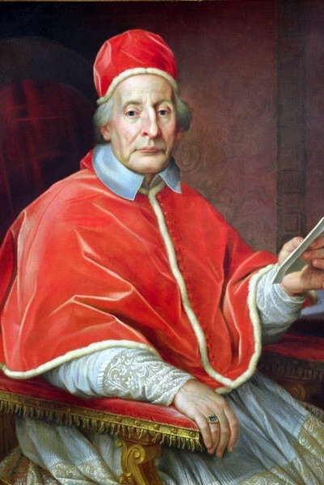
Conformist amber organizations
Formal roles in hierarchical pyramid
Top-down command and control
Stability valued above all
Long-term perspectives
Catholic Church, military, most government agencies, public school systems
Metaphor: army
Gifts: transcendent authority, safety, capacity to create world-wide organizations
Challenges: inflexible, ethnocentric, fears innovation

Slide 19
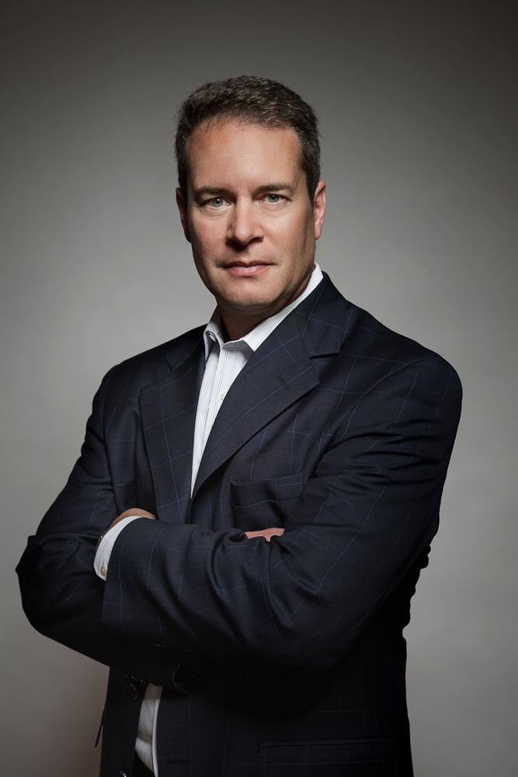
Achievement orange organizations
Beat the competition
Achieve profit and growth
Innovation is the key to staying on top
Management by objectives (command and control on what; freedom on the how)
Accountability
Meritocracy
Multinational companies
Metaphor: machine
Gifts: unprecedented abundance, scientific curiosity & innovation, the optimism to risk
Problems: materialistic, indifferent to nature, social inequality, loss of community, unhappiness at the bottom of the pyramid

Slide 20
Pluralistic green organizations
Still a pyramid structure
Focus on culture and empowerment to achieve extraordinary motivation
Values driven culture
Stakeholder model
Worldcentric and socially responsible
Ben & Jerry's, Southwest Airlines, Google
Metaphor: family
Gifts: happy inclusion, inspired work, humble leadership, benefits the world
Issues: consensus traps, indifference to comparative excellence, over-sensitive, fear of power, ineffective

Slide 21
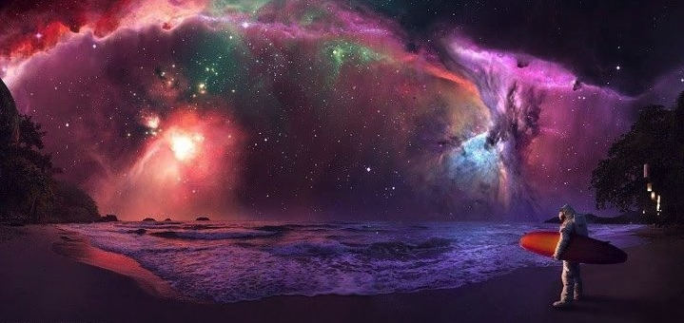
“The most exciting breakthroughs of the twenty-first century will not occur because of technology, but because of an expanding concept of what it means to be human.”
–John naisbitt

Slide 22
Evolutionary teal organizations
Gifts: compassion for all worldviews, scientific AND holistic, authentic, systems thinking
Organizations as living systems
Self-management, based on peer relationships
Reclaim wholeness, bring all of who you are to work
Organization has a life and direction of its own, and we can listen in
Egos claimed and tamed
Trust vs. control
Roles, not job titles
Potential Pathologies: aloofness, insensitivity, elitism, lack of patience

Slide 23
No, it's not consensus
Peer advice process
Consensus gets mired in endless discussion and often ends in exasperated defeat
No consensus, because it dilutes responsibility
Formal processes for internal communications

Slide 24
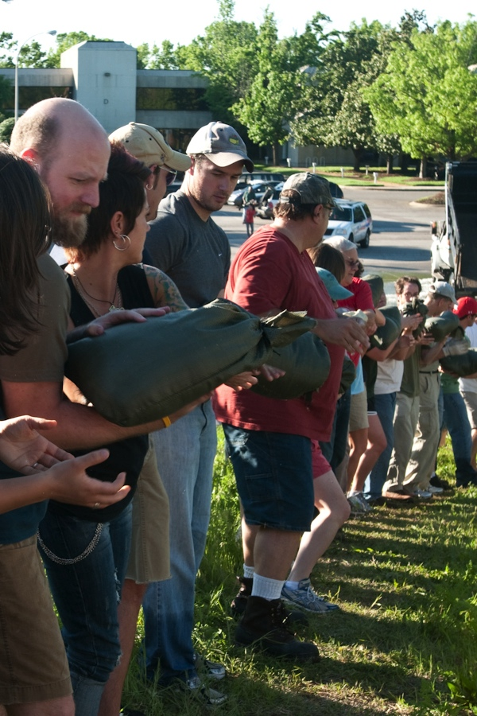
Basic assumptions
People are creative, thoughtful, trustworthy adults
People are accountable and responsible for their decisions and actions
People are fallible and make mistakes, sometimes on purpose
We are unique
We want to use our talents and skills to make a positive contribution to the organization and to the world

Slide 25
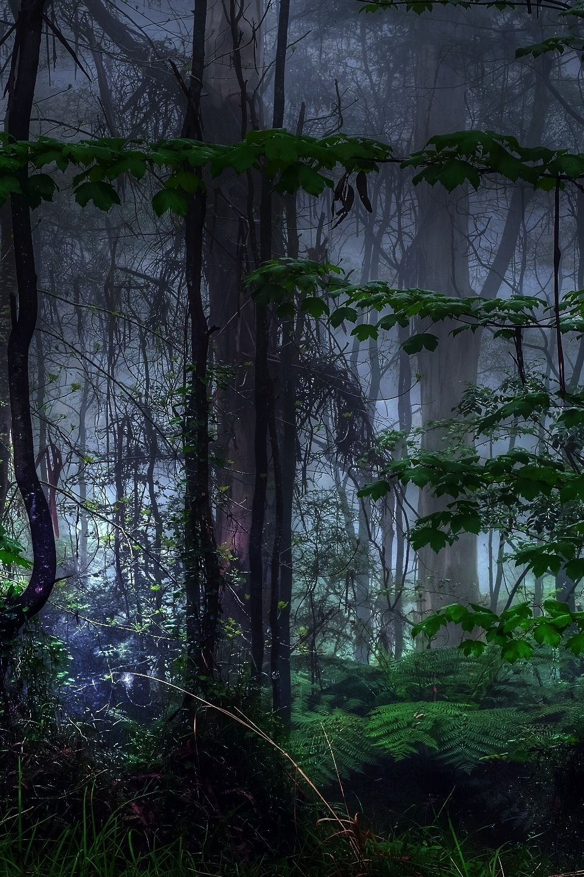
Misperceptions
Of integral organizations
There is no structure, no management, no leadership
Everyone is equal
It's about empowerment
It's still experimental

Slide 26
Welcome to the leading
Edge of culture.
It's pretty crazy, right?

Slide 27
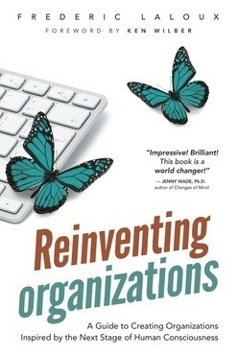
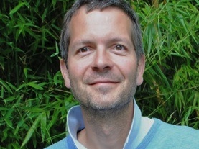
A very special event in Elmira
Tuesday, August 5th at 6:30pm
Grace Episcopal Church
375 W Church Street

Slide 28
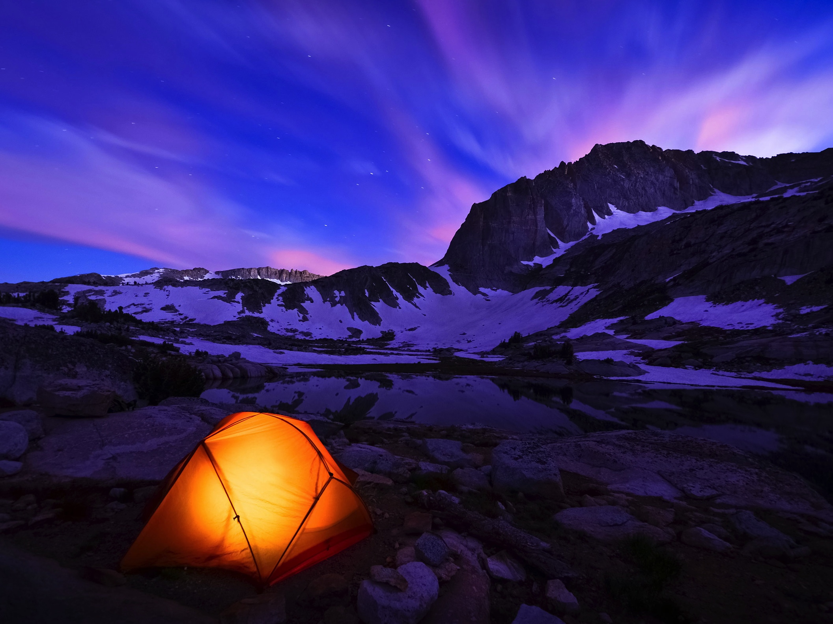
Thanks for your loving listening and participation tonight.....
We are so very grateful for your attention and input
Look for our Facebook page
Look for our website
And especially, look for events and gatherings in the future!

